Slide 1
Chapter 4: Routing Concepts
Routing & Switching
Notes:
Cisco Networking Academy program
Routing Protocols
Chapter 4: Routing Concepts

Slide 2
Chapter 4
4.0 Routing Concepts
4.1 Initial Configuration of a Router
4.2 Routing Decisions
4.3 Router Operation
4.4 Summary

Slide 3
Chapter 4: Objectives
Configure a router to route between directly connected IPv4 and IPv6 networks
Describe the primary functions and features of a router.
Compare ways in which a router builds a routing table.
Explain routing table entries for directly connected networks.
Explain how a router builds a routing table using directly connected networks, static routes and dynamic routing protocol.
Learn how static routes are configured for IPv4 and IPv6 networks
Familiarise with IPv4 and IPv6 routing tables.
Notes:
4.

Slide 4
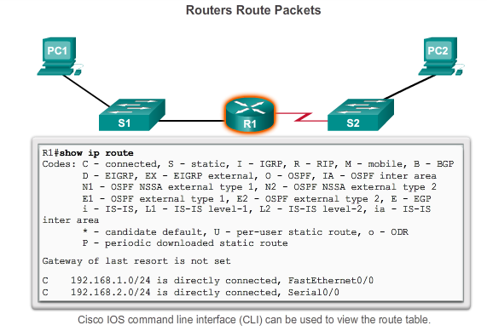
Functions of a Router Why Routing?
Switches (a OSI Layer 2 device) allows communication only between devices in the same network.
The router is a OSI Layer 3 device and is responsible for the routing of traffic between different networks.
The Routing Table in a router showing the networks that the router know.
Notes:
4.1.1.2 Why Routing?

Slide 5
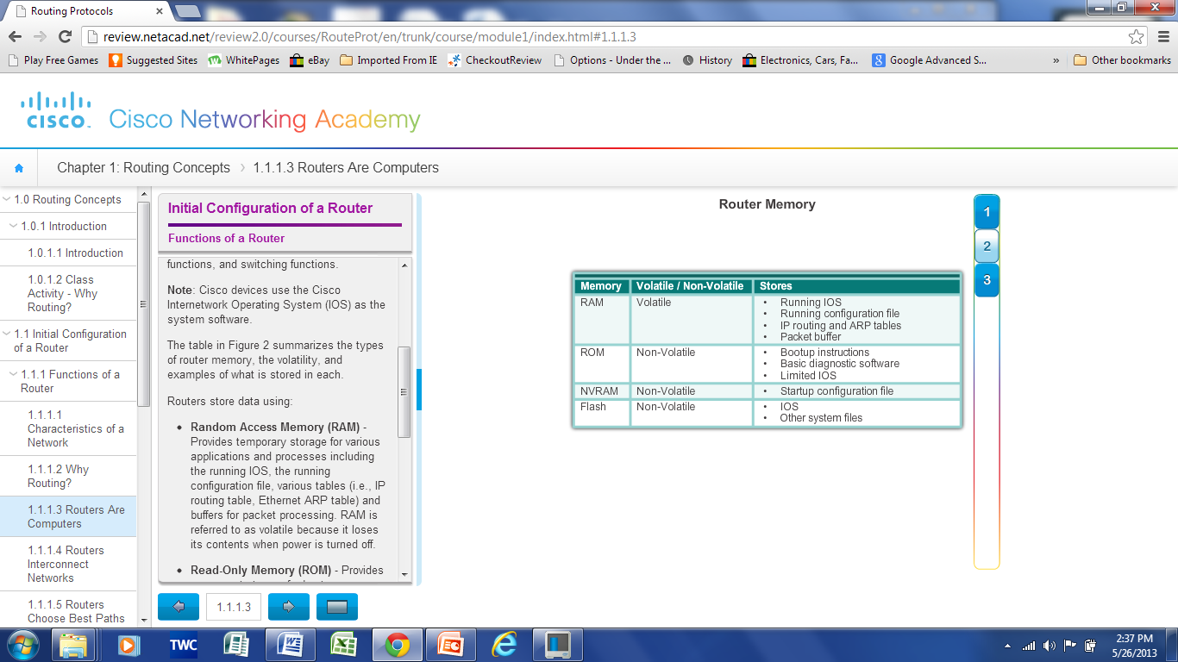
Functions of a Router Routers are Computers
Routers are specialized computers and has these components :
Central processing unit (CPU)
Operating system
Cisco routers use the Internetwork Operating System (IOS)
Memory and storage (RAM, ROM, NVRAM, Flash)
Note the memory location of:-
Startup config
Running config
IOS image
IOS when running
Notes:
4.1.1.3 Routers are Computers

Slide 6
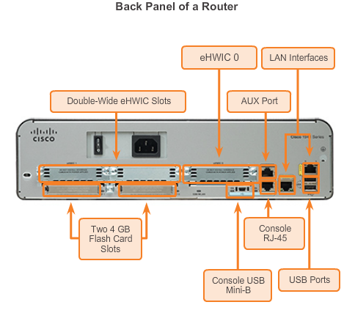
Functions of a Router Routers are Computers
Shown here is a Cisco 1941 router.
Unlike switches, routers have few interfaces:-
LAN (for Ethernet networks)
HWIC (serial interfaces for WAN connections)
Aux and Console (for management)
Notes:
4.1.1.3 Routers are Computers

Slide 7
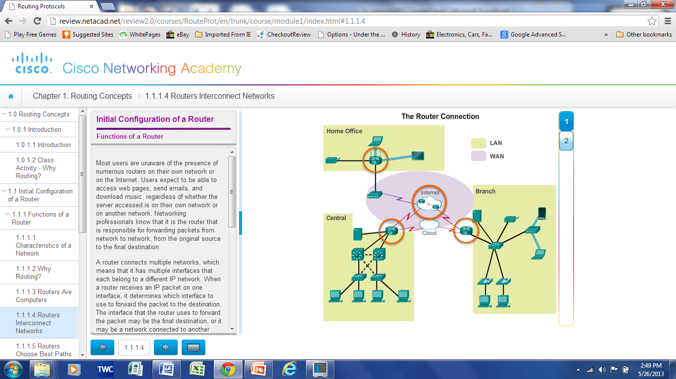
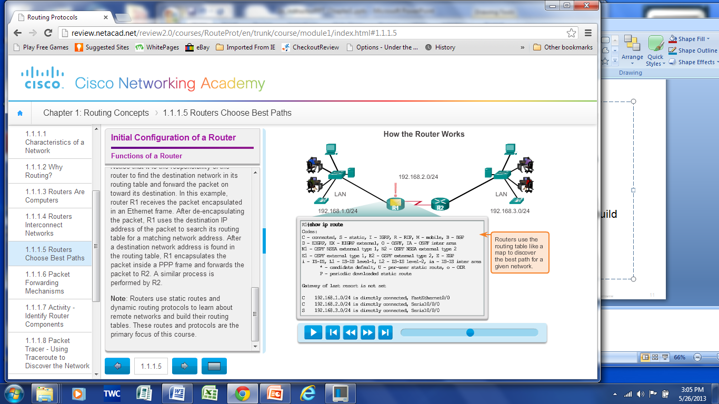
Functions of a Router Router Functions
Connect multiple networks together.
Have multiple interfaces, each connecting a different IP network.
Builds a routing table of routes using its directly connected networks, static routes and remote networks learned from dynamic routing protocols
Use its routing table to determine the best path to send packets.
Encapsulates the packet and forward it to the correct interface indicated in routing table.
Notes:
4.1.1.5 Routers Choose Best Paths

Slide 8
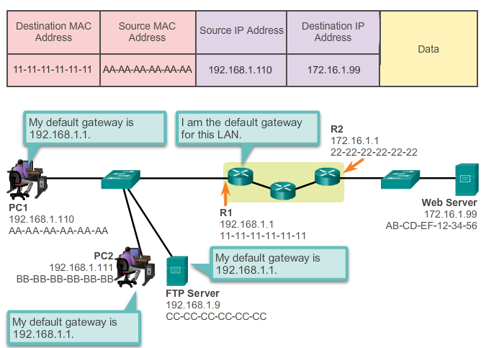
Connect Devices Default Gateways
To enable network access, end devices must be configured with these IP address information:-
IP address - Identifies a unique host on a local network.
Subnet mask - Identifies the host’s network subnet.
Default gateway - Identifies the router a packet is sent to to when the destination is not on the same local network subnet.
Notes:
4.1.2.2 Default Gateways

Slide 9
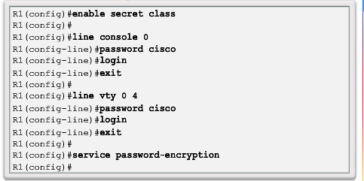
Basic Settings on a Router Basic Router Settings
Hostname – Distinguishes it from other routers
Security – Secures console access, vty access and Privileged Exec password (enable password).
Configure a banner – Provides legal notification against unauthorized access.
Save the Configuration
Notes:
4.1.3.1 Configure Basic Router Settings

Slide 10
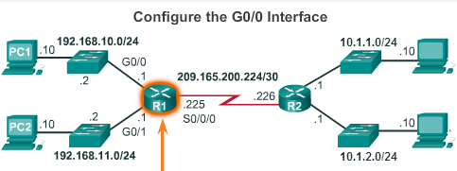
Basic Settings on a Router Configure an IPv4 Router Interface
To be available, a router interface must be:
Configured with an address and subnet mask .
Must be activated using no shutdown command. Router interfaces are shutdown by default.
Serial cable end labelled DCE requires a clock rate.
R1(config)#interface g0/0
R1(config-if)#ip address 192.168.10.1 255.255.255.0
R1(config-if)#no shutdown
R1(config-if)#exit
R1(config)#interface g0/1
R1(config-if)#ip address 192.168.11.1 255.255.255.0
R1(config-if)#no shutdown
R1(config-if)#exit
R1(config)#interface s0/0/0
R1(config-if)#ip address 209.165.200.225 255.255.255.252
R1(config-if)#clock rate 64000
R1(config-if)#no shutdown
Notes:
4.1.3.2 Configure an IPv4 Router Interface

Slide 11
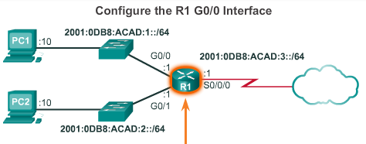
Basic Settings on a Router Configure an IPv6 Router Interface
Note the use of keyword ipv6 in place of ip.
R1(config)#interface g0/0
R1(config-if)#ipv6 address 2001:db8:acad:1::1/64
R1(config-if)#no shutdown
R1(config-if)#exit
R1(config)#interface g0/1
R1(config-if)#ipv6 address 2001:db8:acad:2::1/64
R1(config-if)#no shutdown
R1(config-if)#exit
R1(config)#interface s0/0/0
R1(config-if)#ipv6 address 2001:db8:acad:3::1/64
R1(config-if)#clock rate 64000
R1(config-if)#no shutdown
Notes:
4.1.3.3 Configure an IPv6 Router Interface

Slide 12
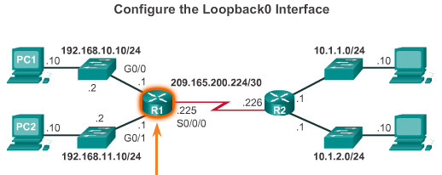
Basic Settings on a Router Configure a Loopback Interface
A loopback interface is a logical interface that is internal to the router:
it is like a software interface that is automatically in an UP state.
Very useful for testing and simulating a network.
R1(config)#interface loopback 0
R1(config-if)#ip address 10.0.0.1 255.255.255.0
R1(config-if)#exit
Notes:
4.1.3.5 Packet Tracer – Configuring IPv4 and IPv6 Interfaces

Slide 13
Verify Connectivity of Directly Connected Networks Verify Interface Settings
Verify IPv4 configuration of interfaces using these commands:
show ip interface brief
show running-config
show interfaces int-id
For IPv6 configuration of interfaces using these commands:
show ipv6 interface brief
show running-config
show interfaces int-id
Notes:
4.1.4.1 Verify Interface Settings

Slide 14
Path Determination Routing Characteristics
Best path
the best way to a destination network
selected by a dynamic routing protocol based on the lowest metric to reach that destination network
Metric
The value used by dynamic routing protocols to measure the “distance” to a given network. Examples:-
Routing Information Protocol (RIP) used Hop count
Open Shortest Path First (OSPF) uses Cost based on the cumulative bandwidth from source to destination
Enhanced Interior Gateway Routing Protocol (EIGRP) uses Composite Metric which is a formula based on bandwidth, delay, load, reliability
Notes:
4.2.2.2 Best Path

Slide 15
Path Determination Routing Characteristics
Administrative Distance (AD)
AD represents the “trustworthiness” of a route, the lower the value the more trustworthy the route is.
If there are multiple routes to a destination, the router uses the AD to determine the one to install into the routing table.
A static route (AD of 1) is more reliable than an EIGRP-discovered route (AD of 90).
A directly connected route (AD of 0) is more reliable than a static route (AD of 1).
Route Source | AD
Connected | 0
Static | 1
EIGRP summary route | 5
External BGP | 20
Internal EIGRP | 90
IGRP | 100
OSPF | 110
IS-IS | 115
RIP | 120
External EIGRP | 170
Internal BGP | 200
Notes:
4.2.2.4 Administrative Distance
4.2.2.5 Activity – Order the Steps in the Packet Forwarding Process

Slide 16
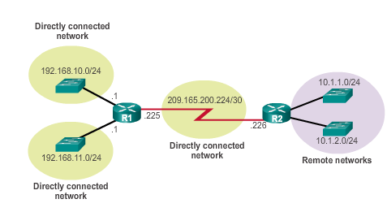
The Routing Table The Routing Table
A routing table is a data file stored in RAM that contains information about:
Directly connected routes
Remote routes
Next hop associations or Exit Interfaces
Directly connected networks and remote networks for router R1
Notes:
4.3.1.1 The Routing Table

Slide 17
The Routing Table Routing Table Sources
The show ip route command displays the routing table which shows:
Directly connected interfaces
Added to the routing table once its interface is configured and active.
Static routes
Added when a route is manually configured and the exit interface is active.
Routes learned through Dynamic routing protocol
Added when a dynamic routing protocol is implemented and networks are identified.
Local route interfaces (IOS 15 onwards)
Added to the routing table once its interface is configured and active
Notes:
4.3.1.2 Routing Table Sources

Slide 18
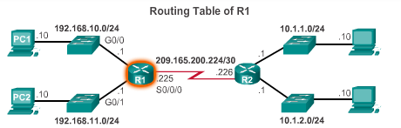
The Routing Table Routing Table Sources
R1#show ip route
Codes: L - local, C - connected, S - static, R - RIP, M - mobile, B - BGP
D - EIGRP, EX - EIGRP external, O - OSPF, IA - OSPF inter area
N1 - OSPF NSSA external type 1, N2 - OSPF NSSA external type 2
E1 - OSPF external type 1, E2 - OSPF external type 2, E - EGP
i - IS-IS, L1 - IS-IS level-1, L2 - IS-IS level-2, ia - IS-IS inter area
* - candidate default, U - per-user static route, o - ODR
P - periodic downloaded static route
Gateway of last resort is not set
10.0.0.0/24 is subnetted, 2 subnets
R 10.1.1.0/24 [120/1] via 209.165.200.226, 00:00:21, Serial0/0/0
R 10.1.2.0/24 [120/1] via 209.165.200.226, 00:00:21, Serial0/0/0
192.168.10.0/24 is variably subnetted, 2 subnets, 2 masks
C 192.168.10.0/24 is directly connected, GigabitEthernet0/0
L 192.168.10.1/32 is directly connected, GigabitEthernet0/0
192.168.11.0/24 is variably subnetted, 2 subnets, 2 masks
C 192.168.11.0/24 is directly connected, GigabitEthernet0/1
L 192.168.11.1/32 is directly connected, GigabitEthernet0/1
209.165.200.0/24 is variably subnetted, 2 subnets, 2 masks
C 209.165.200.224/30 is directly connected, Serial0/0/0
L 209.165.200.225/32 is directly connected, Serial0/0/0
Notes:
4.3.1.2 Routing Table Sources

Slide 19
The Routing Table Routing Table Entries
R1# show ip route
<output omitted>
R 10.1.1.0/24 [120/1] via 209.165.200.226, 00:00:21, Serial0/0/0
Output | Description
R | Identifies the source of route as RIP
10.1.1.0 | Indicates the address of the remote network
/24 | Indicated the subnet prefix of remote network
[120/1] | Shows Administrative Distance (120) and metric (1 hop)
via 209.165.200.226 | Specifies the IP address of the adjacent router (R2) to send traffic to in order to get to the remote network
00:00:21 | Specifies the amount of time since the route was last updated (21s)
Serial0/0/0 | Specifies the local interface through which the remote network can be reached.
Notes:
4.3.1.3 Remote Network Routing Entries
4.3.1.4 Activity- Interpret the Content of a Routing Table Entry

Slide 20
Directly Connected Routes Directly Connected Interfaces
A newly deployed router, without any configured interfaces, has an empty routing table.
After configuring and bringing up a router interface, the router immediately creates two routing table entries:
Directly Connected (C)
Link Local (L)
R1#show ip route
<-- output omitted -->
192.168.10.0/24 is variably subnetted, 2 subnets, 2 masks
C 192.168.10.0/24 is directly connected, GigabitEthernet0/0
L 192.168.10.1/32 is directly connected, GigabitEthernet0/0
<-- output omitted -->
Notes:
4.3.2.1 Directly Connected Interfaces
4.3.2.2 Directly Connected Route Table Entries

Slide 21
Statically Learned Routes Static Routes
Are manually configured by an administrator.
Define the forwarding path to a destination network.
Disadvantage: needs to be manually updated if the route or topology changes.
Advantage: Improve security and control of resources.
To configure a network static route:
R1(config)#ip route network mask {next-hop-ip | exit-int}
A default static route is a “last resort” route used when the destination network doesn’t exist in the routing table.
To configure a default static route:
R1(config)#ip route 0.0.0.0 0.0.0.0 {next-hop-ip | exit-int}
Notes:
4.3.3.1 Static Routes

Slide 22
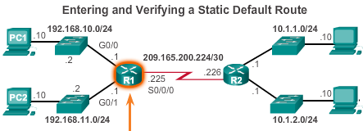
Statically Learned Routes Default Static Routes Example
R1(config)#ip route 0.0.0.0 0.0.0.0 s0/0/0
R1(config)#exit
R1#show ip route
<-- output omitted -->
Gateway of last resort is 0.0.0.0 to network 0.0.0.0
S* 0.0.0.0/0 is directly connected, Serial0/0/0
<-- output omitted -->
Notes:
4.3.3.2 Default Static Routes Example

Slide 23
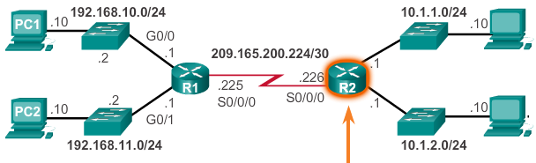
Statically Learned Routes Network Static Routes Example
Next-hop-IP Exit-int
R2(config)#ip route 192.168.10.0 255.255.255.0 s0/0/0
R2(config)#ip route 192.168.11.0 255.255.255.0 209.165.200.225
R2(config)#exit
R1#show ip route
<-- output omitted -->
Gateway of last resort is not set
S 192.168.10.0/24 is directly connected, Serial0/0/0
S 192.168.11.0/24 [1/0] via 209.165.200.225
<-- output omitted -->
exit-int or next-hop IP. Either way works
Notes:
4.3.3.2 Static Routes Example (cont.)

Slide 24
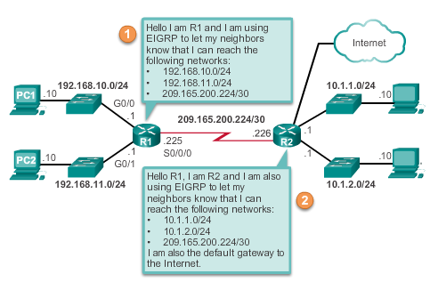
Dynamic Routing Protocols Dynamic Routing
Dynamic routing is used by routers to share information about the reachability and status of remote networks. It performs network discovery and maintains routing tables.
Some dynamic routing protocols are :
RIP – Routing Information Protocol
OSPF – Open Shortest Path First
EIGRP – Enhanced Interior Gateway Routing Protocol
IS-IS – Intermediate System-to-Intermediate System
Notes:
4.3.4.1 Dynamic Routing

Slide 25
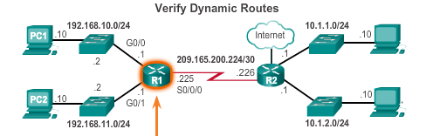
Dynamic Routing Protocols IPv4 Routing Protocols
Note:
Below example was configured using RIP (R).
In NetAcad, the example was configured using EIGRP (D).
Thus the difference in the route code.
R1#show ip route
Codes: L - local, C - connected, S - static, R - RIP, M - mobile, B - BGP
D - EIGRP, EX - EIGRP external, O - OSPF, IA - OSPF inter area
N1 - OSPF NSSA external type 1, N2 - OSPF NSSA external type 2
E1 - OSPF external type 1, E2 - OSPF external type 2, E - EGP
i - IS-IS, L1 - IS-IS level-1, L2 - IS-IS level-2, ia - IS-IS inter area
* - candidate default, U - per-user static route, o - ODR
P - periodic downloaded static route
Gateway of last resort is not set
10.0.0.0/24 is subnetted, 2 subnets
R 10.1.1.0/24 [120/1] via 209.165.200.226, 00:00:21, Serial0/0/0
R 10.1.2.0/24 [120/1] via 209.165.200.226, 00:00:21, Serial0/0/0
192.168.10.0/24 is variably subnetted, 2 subnets, 2 masks
C 192.168.10.0/24 is directly connected, GigabitEthernet0/0
L 192.168.10.1/32 is directly connected, GigabitEthernet0/0
<-- output omitted -->
Notes:
4.3.4.3 IPv4 Routing Protocols Example

Slide 26
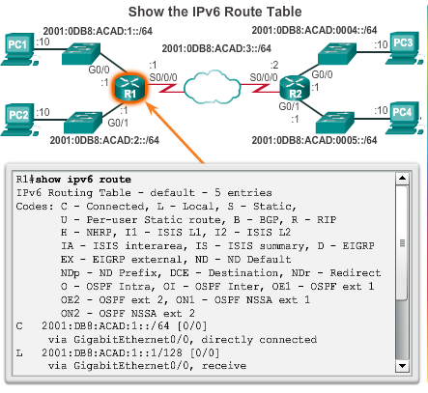
Directly Connected Routes Directly Connected IPv6 Example
If IPv6 addresses are used in your network, use
# show ipv6 route
to show the ipv6 networks and routes installed in the routing table.
Notes:
4.3.2.4 Directly Connected IPv6 Example
4.3.2.5 Packet Tracer – Investigating Directly Connected Routes

Slide 27
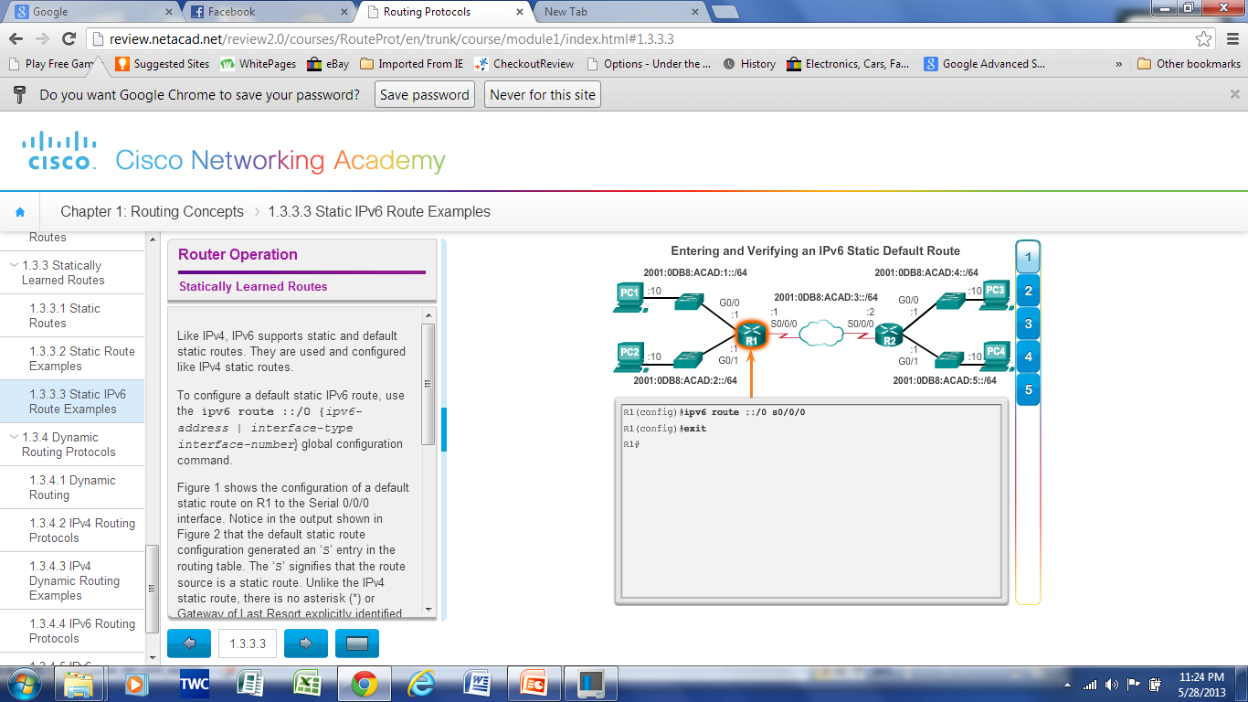
Statically Learned Routes Static IPv6 Routes Example
For IPv6 addresses, a default static route can be added as shown.
For router R1:-
R1(config)#ipv6 route ::/0 s0/0/0
R1(config)#exit
R1#show ipv6 route
<-- output omitted -->
S ::/0 [1/0]
via Serial0/0/0, directly connected
<-- output omitted -->
Notes:
4.3.3.3 Static IPv6 Route Example

Slide 28
Statically Learned Routes Static IPv6 Routes Example
For IPv6 addresses, network static routes can be added as shown.
For router R2:-
R2(config)#ipv6 route 2001:0db8:acad:1::/64 2001:0db8:acad:3::1
R2(config)#ipv6 route 2001:0db8:acad:2::/64 s0/0/0
R2#show ipv6 route
<-- output omitted -->
S 2001:DB8:ACAD:1::/64 [1/0]
via 2001:DB8:ACAD:3::1
S 2001:DB8:ACAD:2::/64 [1/0]
via Serial0/0/0, directly connected
<-- output omitted -->
exit-int or next-hop IP. Either way works
Notes:
4.3.3.3 Static IPv6 Route Example

Slide 29
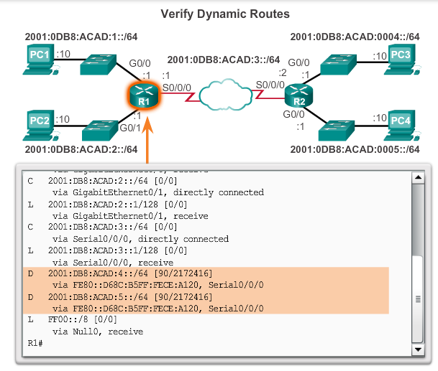
Dynamic Routing Protocols IPv6 Routing Protocols
This example uses EIGRP as the dynamic routing protocol.
Thus the route code for the remote route is D.
Notes:
4.3.4.5 IPv6 Routing Protocols Example

Slide 30
Chapter 4: Summary
Routers connect multiple networks and forward packets from one network to the next. Each interface is a member or host on a different IP network.
The routing table is a list of networks known by the router.
A remote network is a network that can only be reached by forwarding the packet to another router.
Remote networks are added to the routing table in two ways:
Either by the network administrator manually configuring static routes
Or by implementing a dynamic routing protocol.
Static routes do not have as much overhead as dynamic routing protocols; however, static routes can require more maintenance if the topology is constantly changing or is unstable.
Notes:
Chapter 4 Summary

Slide 31
Chapter 4: Summary (cont.)
Dynamic routing protocols automatically adjust to changes without any intervention from the network administrator. Dynamic routing protocols require more CPU processing and also use a certain amount of link capacity for routing updates and messages.
Components of the IPv6 routing table are very similar to the IPv4 routing table. For instance, it is populated using directly connected interfaces, static routes and dynamically learned routes.
Notes:
Chapter 4 Summary

